Slide 1

8th Grade Math: Pre-Algebra
Unit 3, Lesson 8 Solving Real-World Problems Involving Numbers Expressed in Scientific Notation Volume 1, pg. 115

Slide 2


Benchmark
MA.8.NSO.1.6
Solve real-world problems involving operations with numbers expressed in scientific notation.
volume 1, pg. 115

Slide 3
Integrated Mathematical Thinking and Reasoning Standards
MA.K12.MTR.1.1 Actively participate in effortful learning both individually and collectively.
MA.K12.MTR.3.1 Complete tasks with mathematical fluency.
MA.K12.MTR.4.1 Engage in discussions that reflect on the mathematical thinking of self and others.
MA.K12.MTR.6.1 Assess the reasonableness of solutions.
MA.K12.MTR.7.1 Apply mathematics to real-world contexts.
volume 1, pg. 115

Slide 4

Learning Targets
I can solve real-world problems involving operations with numbers expressed in scientific notation.
I can express answers in scientific notation using significant digits.
volume 1, pg. 115

Slide 5

Warm-Up
volume 1, pg. 115

Slide 6
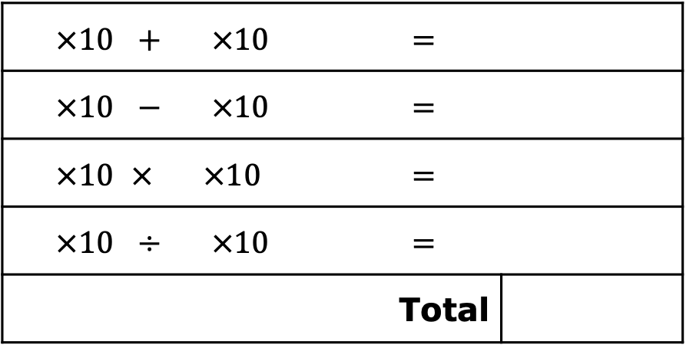
3.8.1 Warm-Up: Critical Thinking
Using the digits $1−9$ at most twice each, create the sum of the four expressions that has the greatest possible value.
$$×{10}^{ }+ ×{10}^{ }$$ | $$=$$
$$×{10}^{ }− ×{10}^{ }$$ | $$=$$
$$×{10}^{ }× ×{10}^{ }$$ | $$=$$
$$×{10}^{ }÷ ×{10}^{ }$$ | $$=$$
Total
volume 1, pg. 115
Notes:
Video Link: https://algebranation.wistia.com/medias/fi4fidi5y8

Slide 7

Guided Instruction
volume 1, pg. 116

Slide 8

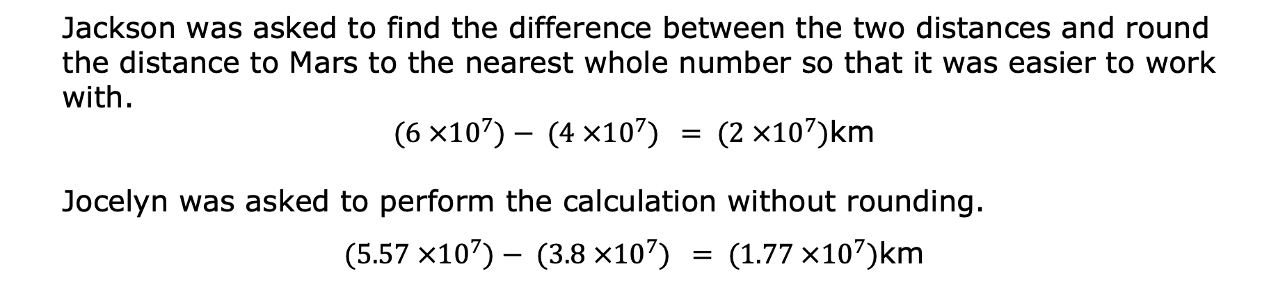
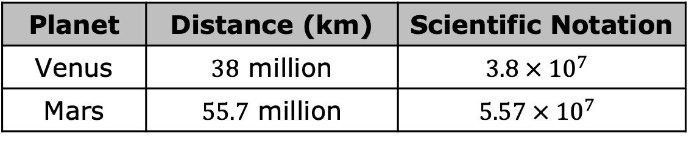
3.8.2 Guided Instruction: Understanding Significant Digits in Scientific Notation
The table shows the distance from Earth, in kilometers (km), to the nearest two planets.
Planet | Distance (km) | Scientific Notation
Venus | $38$ million | $$3.8 × {10}^{7}$$
Mars | $55.7$ million | $$5.57 × {10}^{7}$$
Jackson was asked to find the difference between the two distances and round the distance to Mars to the nearest whole number so that it was easier to work with.
$(6 ×{10}^{7})− (4 ×{10}^{7}) = (2 ×{10}^{7})$km
Jocelyn was asked to perform the calculation without rounding.
$(5.57 ×{10}^{7})− (3.8 ×{10}^{7}) = (1.77 ×{10}^{7})$km
volume 1, pg. 116

Slide 9
What is the difference, in km, between the two answers?
Discuss with your partner why Jocelyn’s answer is more precise.
volume 1, pg. 116

Slide 10

Significant digits are non-zero digits of a number and the zeros that are included between them or any trailing zeros that are considered to be precise.
Based on the definition, how many significant digits are in the representations of the distances for Mars and Venus?
volume 1, pg. 116

Slide 11
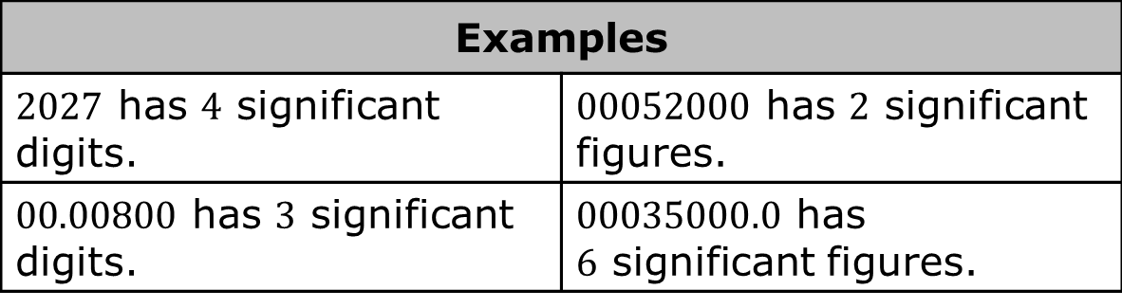
There are three rules for determining how many significant figures are in a number:
Non-zero digits are always significant.
Any zeros between two significant digits are significant.
A final zero or trailing zeros in the decimal portion ONLY are significant.
Examples
$2027$ has $4$ significant digits. | $00052000$ has $2$ significant figures.
$00.00800$ has $3$ significant digits. | $00035000.0$ has $6$ significant figures.
volume 1, pg. 116

Slide 12
Sometimes answers written in scientific notation are written using a specific number of significant digits. If two numbers are written with different precision, then the precision is the least number of significant digits.
Discuss with your partner the given values of the distance from Earth to Mars and Venus. Determine how many significant digits should be used to represent the difference between Mars and Venus.
volume 1, pg. 116

Slide 13
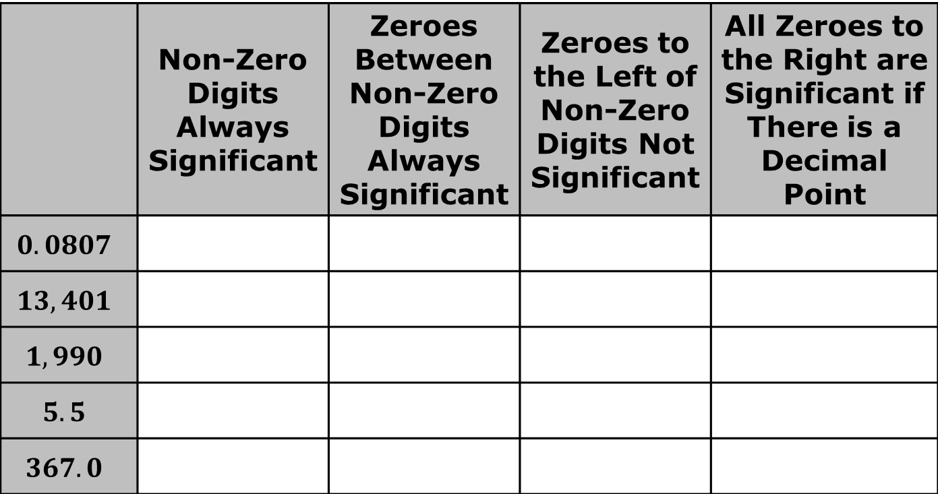
Circle the significant digits in each number. Place a check in the column(s) to reflect which rule(s) you used when making your decision.
 | Non-Zero Digits Always Significant | Zeroes Between Non-Zero Digits Always Significant | Zeroes to the Left of Non-Zero Digits Not Significant | All Zeroes to the Right are Significant if There is a Decimal Point
$$0.0807$$
$$13,401$$
$$1,990$$
$$5.5$$
$$367.0$$
volume 1, pg. 117

Slide 14
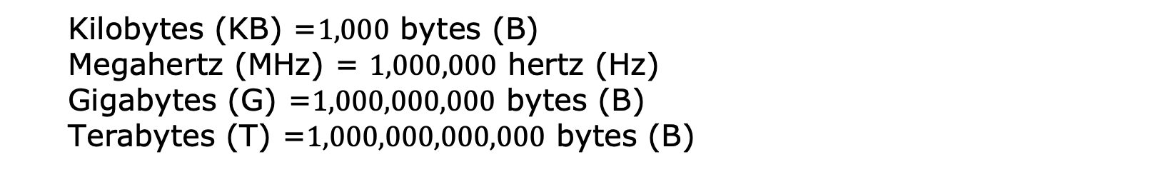
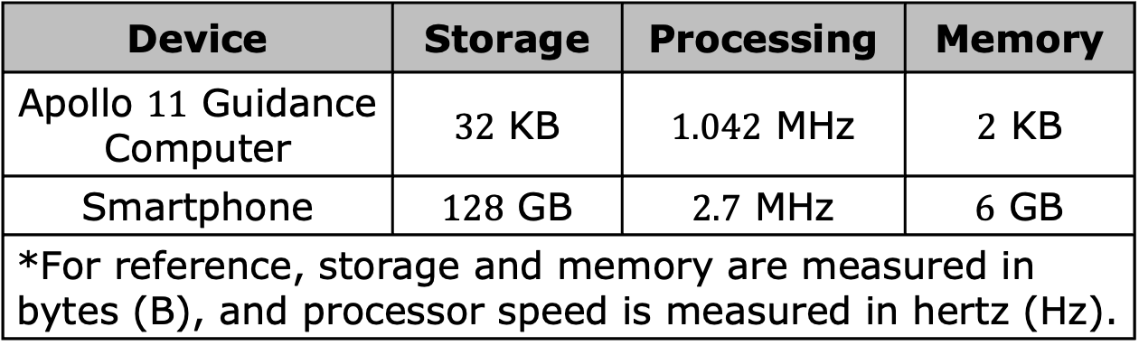
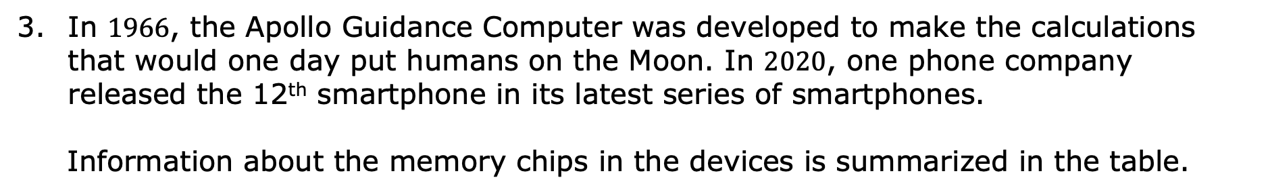
In $1966$, the Apollo Guidance Computer was developed to make the calculations that would one day put humans on the Moon. In $2020$, one phone company released the 12th smartphone in its latest series of smartphones.
Information about the memory chips in the devices is summarized in the table.
Device | Storage | Processing | Memory
Apollo $11$ Guidance Computer | $32$ KB | $1.042$ MHz | $2$ KB
Smartphone | $128$ GB | $2.7$ MHz | $6$ GB
*For reference, storage and memory are measured in bytes (B), and processor speed is measured in hertz (Hz).
Kilobytes (KB) =$1,000$ bytes (B)
Megahertz (MHz) = $1,000,000$ hertz (Hz)
Gigabytes (G) =$1,000,000,000$ bytes (B)
Terabytes (T) =$1,000,000,000,000$ bytes (B)
volume 1, pg. 117

Slide 15
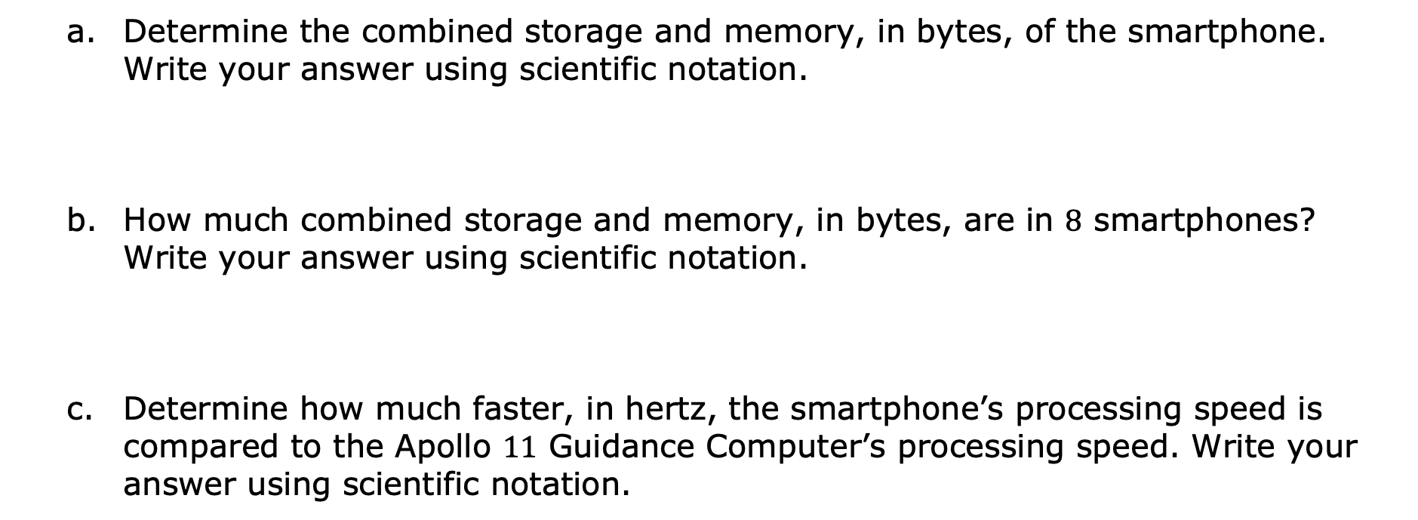
Determine the combined storage and memory, in bytes, of the smartphone. Write your answer using scientific notation.
How much combined storage and memory, in bytes, are in $8$ smartphones? Write your answer using scientific notation.
Determine how much faster, in hertz, the smartphone’s processing speed is compared to the Apollo $11$ Guidance Computer’s processing speed. Write your answer using scientific notation.
volume 1, pg. 117

Slide 16
Guided Instruction
volume 1, pg. 118

Slide 17
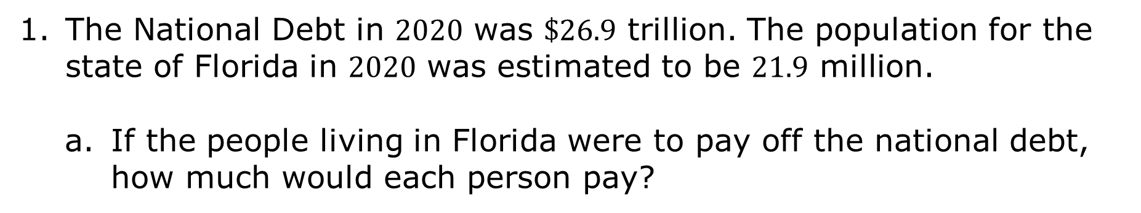
3.8.3 Guided Instruction: Using Scientific Notation to Solve Real-World Problems
The National Debt in $2020$ was $\$26.9$ trillion. The population for the state of Florida in $2020$ was estimated to be $21.9$ million.
If the people living in Florida were to pay off the national debt, how much would each person pay?
volume 1, pg. 118

Slide 18
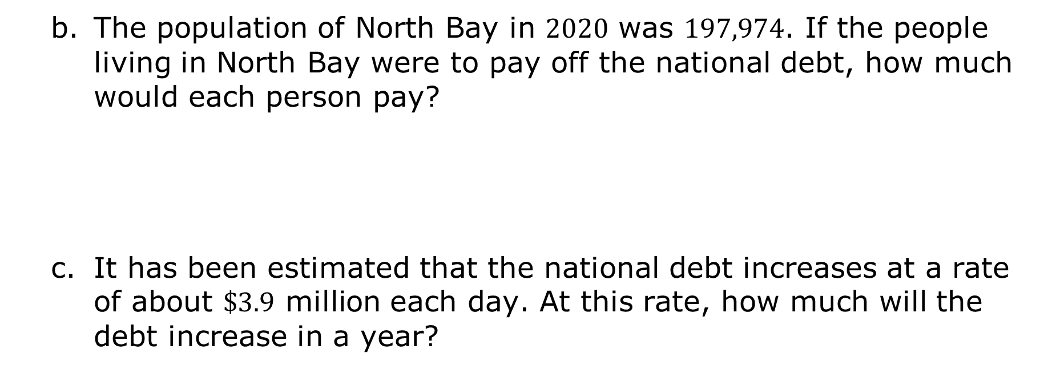
The population of North Bay in $2020$ was $197,974$. If the people living in North Bay were to pay off the national debt, how much would each person pay?
It has been estimated that the national debt increases at a rate of about $\$3.9$ million each day. At this rate, how much will the debt increase in a year?
volume 1, pg. 118

Slide 19

Your Turn
volume 1, pg. 118

Slide 20
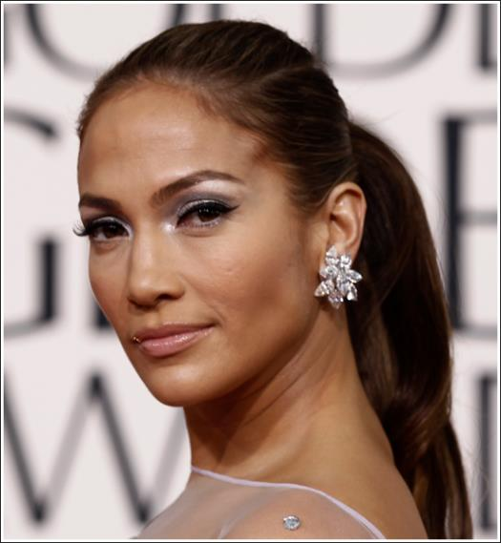
3.8.4 Your Turn!
Jennifer Lopez changed the Hollywood landscape, single-handedly increasing Latino representation in film, television, and fashion. J.Lo, as she is known, has become one of the highest-paid Latina celebrities in Hollywood. She has multiple income streams.
volume 1, pg. 118

Slide 21

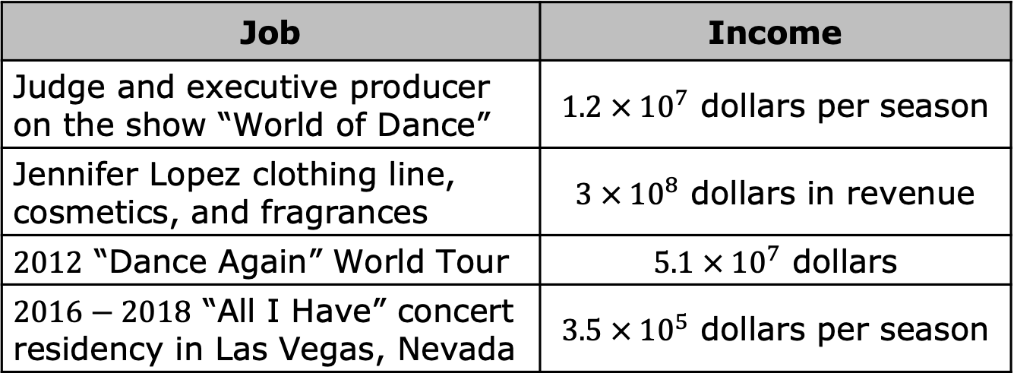
The table summarizes her income from some of her recent jobs.
What is the difference in Jennifer Lopez’s income from the “Dance Again” World Tour and $2016−2018$ concert residency in Las Vegas, Nevada?
What is the sum of Jennifer Lopez’s income from “World of Dance” and her clothing line, cosmetics, and fragrances?
Job | Income
Judge and executive producer on the show “World of Dance” | $1.2 × {10}^{7}$ dollars per season
Jennifer Lopez clothing line, cosmetics, and fragrances | $3 × {10}^{8}$ dollars in revenue
$2012$ “Dance Again” World Tour | $5.1 × {10}^{7}$ dollars
$2016−2018$ “All I Have” concert residency in Las Vegas, Nevada | $3.5 × {10}^{5}$ dollars per season
volume 1, pg. 118

Slide 22
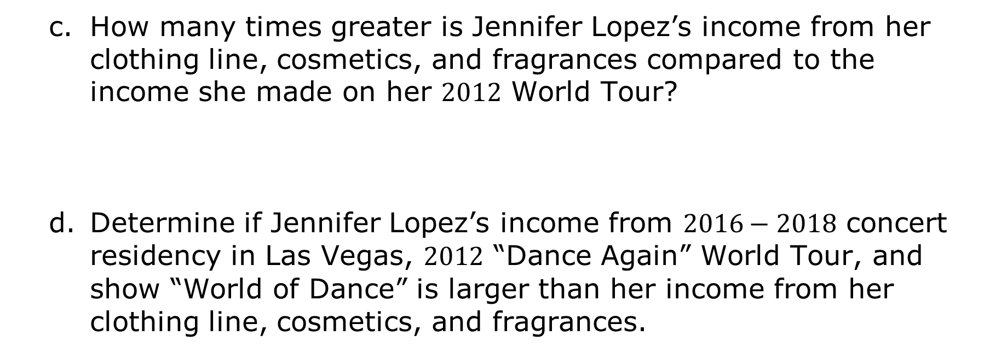
How many times greater is Jennifer Lopez’s income from her clothing line, cosmetics, and fragrances compared to the income she made on her $2012$ World Tour?
Determine if Jennifer Lopez’s income from $2016−2018$ concert residency in Las Vegas, $2012$ “Dance Again” World Tour, and show “World of Dance” is larger than her income from her clothing line, cosmetics, and fragrances.
volume 1, pg. 119

Slide 23
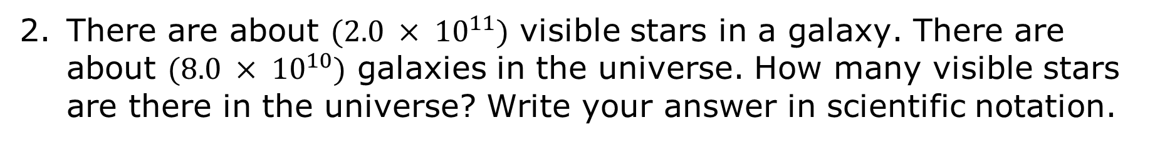
There are about $(2.0 × {10}^{11})$ visible stars in a galaxy. There are about $(8.0 × {10}^{10})$ galaxies in the universe. How many visible stars are there in the universe? Write your answer in scientific notation.
volume 1, pg. 119

Slide 24

Wrap-Up
volume 1, pg. 119

Slide 25

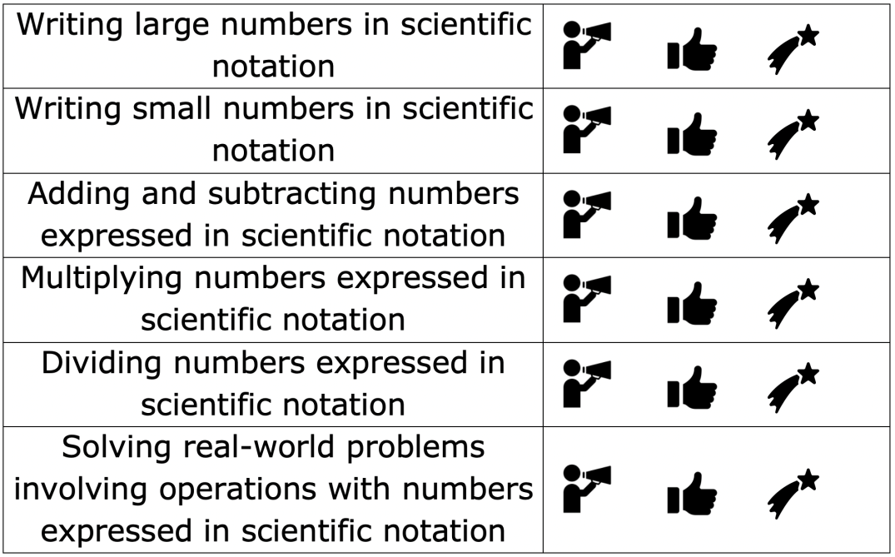
3.8.5 Wrap-Up: Reflection
Circle the icon that best describes your understanding of each concept.
volume 1, pg. 119

